Slide 1

Neural Networks Introduction @DETERMINED 2022 Workshop
Dr. U. Michelucci (TOELT)

Slide 2
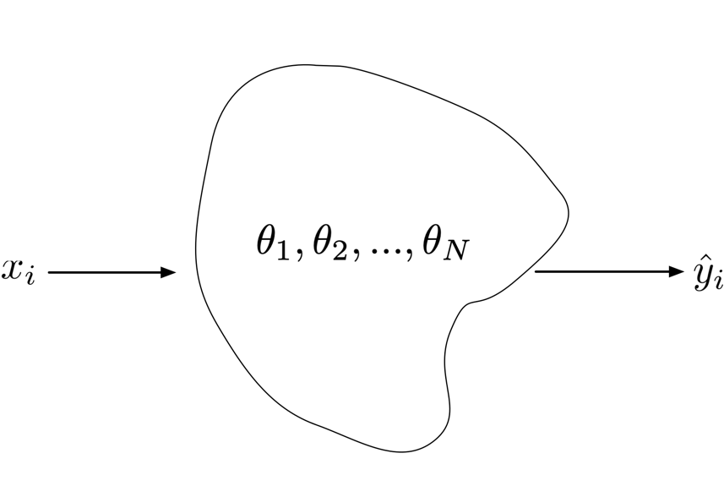
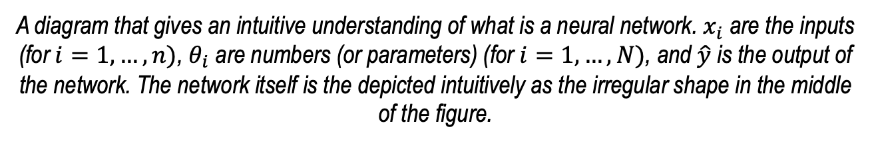
An intuitive understanding of a neural network
A diagram that gives an intuitive understanding of what is a neural network. $x_{i}$ are the inputs (for $i=1,…,n)$, $θ_{i}$ are numbers (or parameters) (for $i=1,…,N)$, and $\hat{y}$ is the output of the network. The network itself is the depicted intuitively as the irregular shape in the middle of the figure.

Slide 3
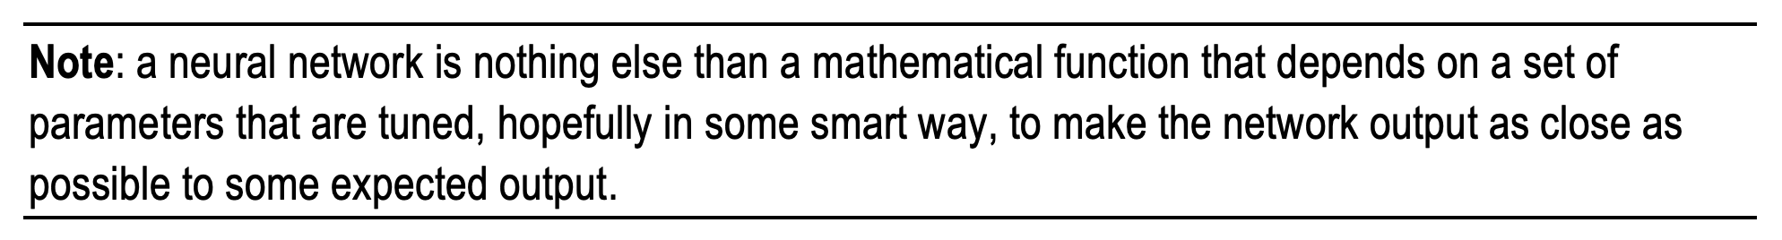
A somewhat imprecise definition
U. Michelucci, Applied Deep Learning with TensorFlow 2, Springer Nature, 2022

Slide 4
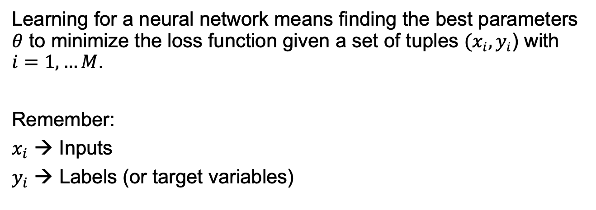
Learning in the context of neural networks
Learning for a neural network means finding the best parameters $θ$ to minimize the loss function given a set of tuples $(x_{i}, y_{i}$) with $i=1,…M$.
Remember:
$x_{i}$ → Inputs
$y_{i}$ → Labels (or target variables)

Slide 5
The 3 main components of a neural network model
The neural network architecture (type of network, number of layers, etc.)
The loss function (the one we want to minimise)
The optimiser (the algorithm to find the minimum of the loss function)

Slide 6
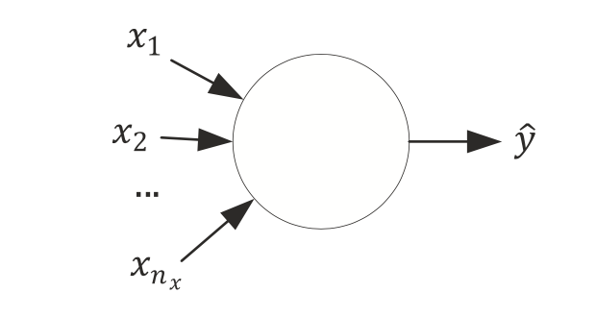
A neuron without details

Slide 7
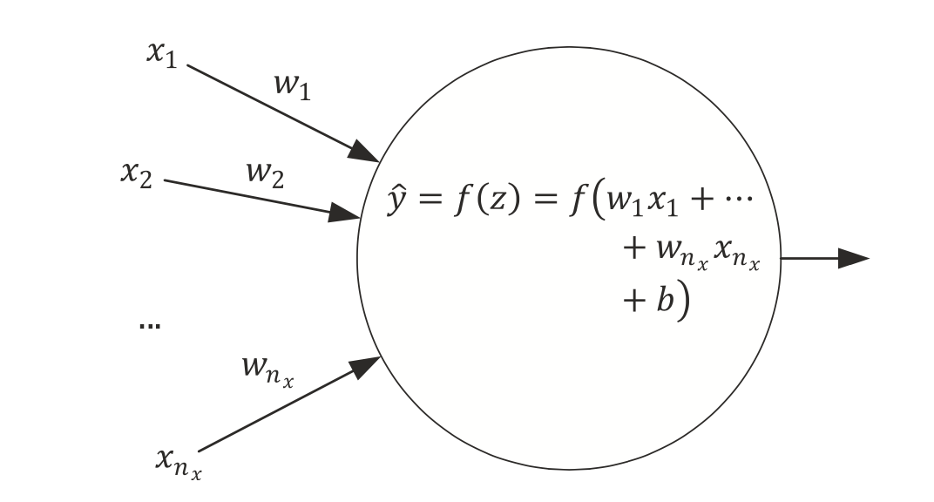
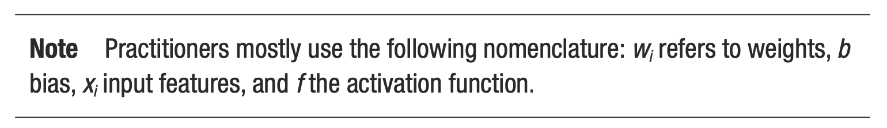
Simplest network possible
The simplest neural network that we can create is made of one single neuron.
Source:Umberto Michelucci, Applied Deep Learning - A Case-Based Approach to Understanding Deep Neural Networks, APRESS 2018

Slide 8
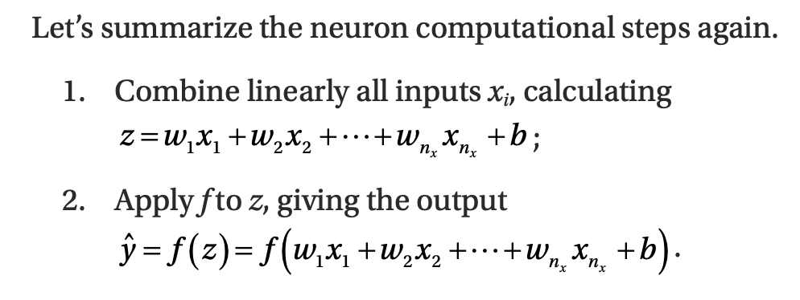
Computational Steps of a single neuron
Source:Umberto Michelucci, Applied Deep Learning - A Case-Based Approach to Understanding Deep Neural Networks, APRESS 2018

Slide 9
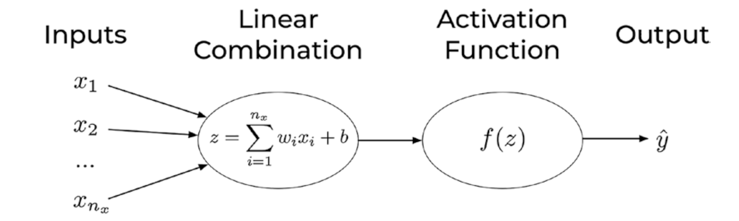
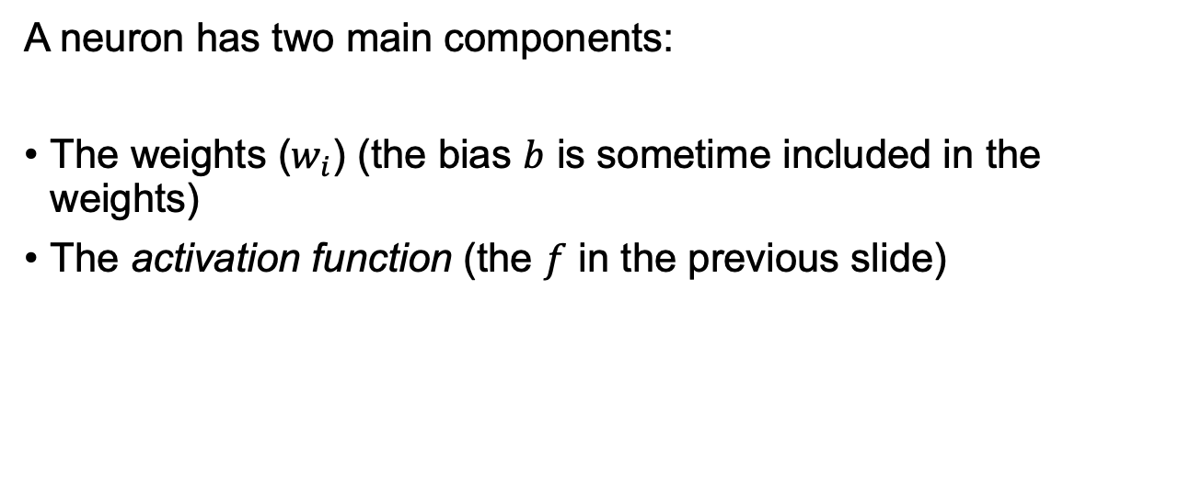
Components of a neuron
A neuron has two main components:
The weights ($w_{i}$) (the bias $b$ is sometime included in the weights)
The activation function (the $f$ in the previous slide)
U. Michelucci, Applied Deep Learning with TensorFlow 2, Springer Nature, 2022

Slide 10
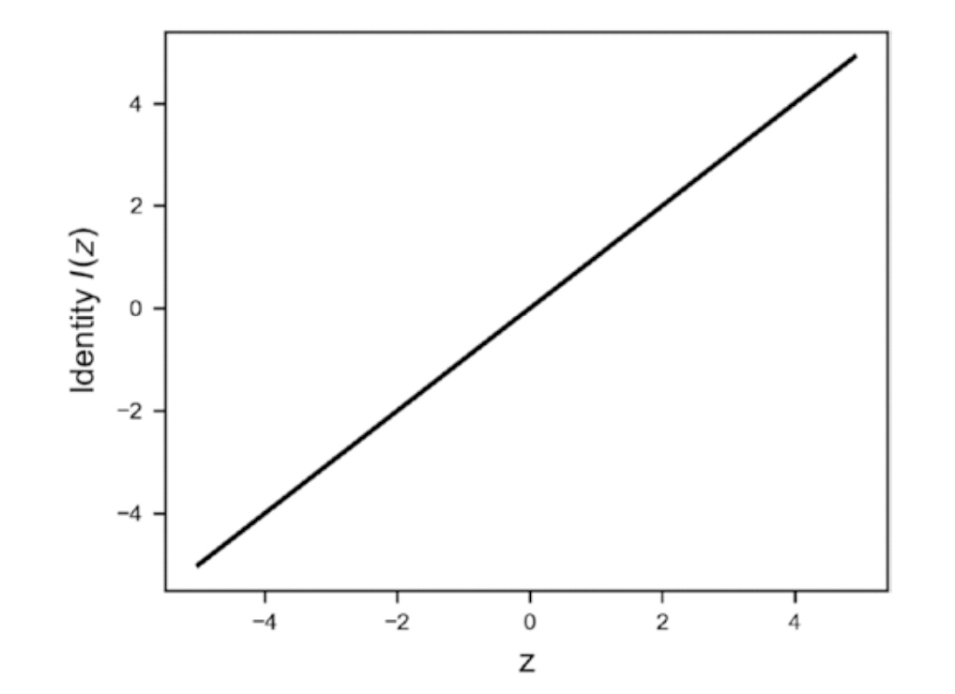
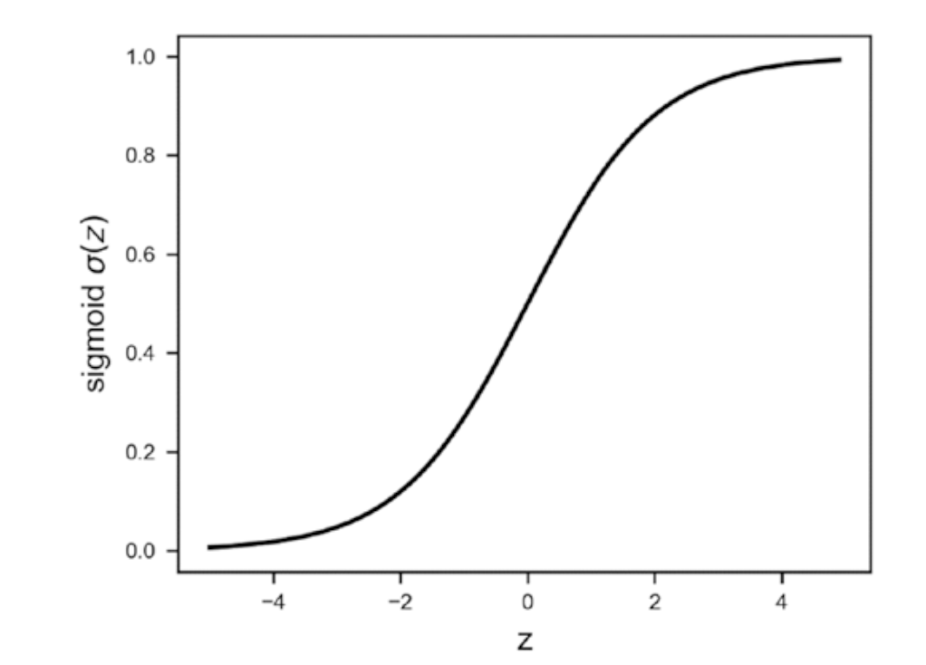
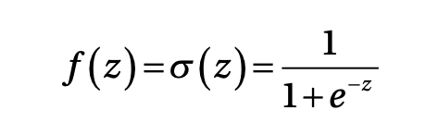
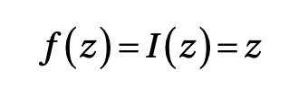
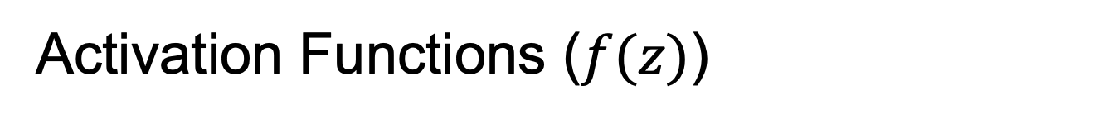
Activation Functions ($f(z)$)
Identity
Sigmoid

Slide 11
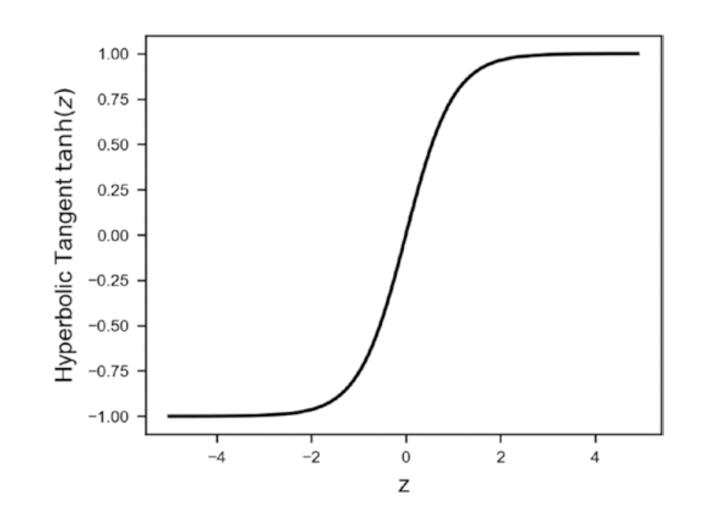
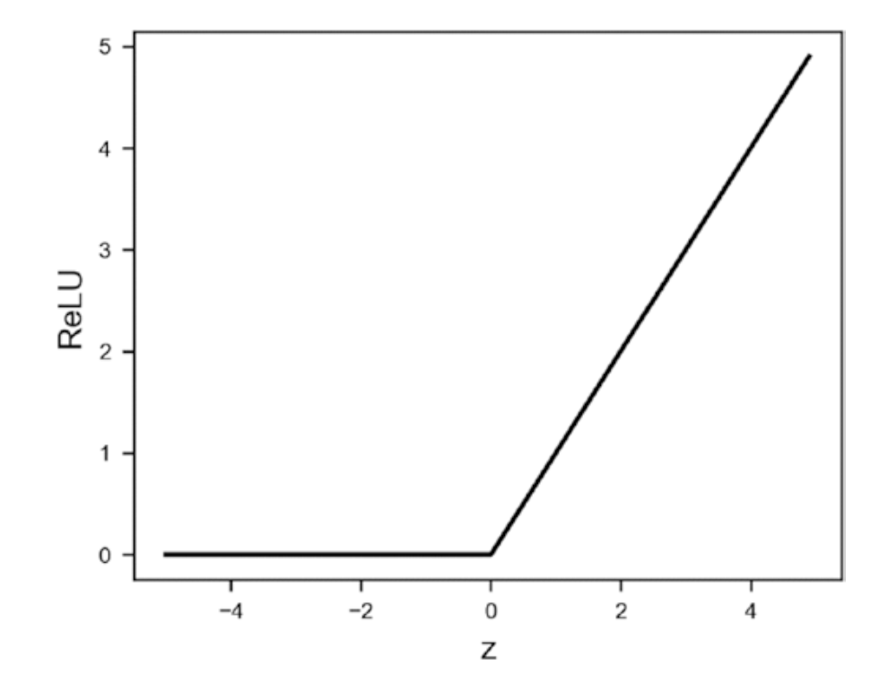
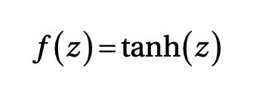
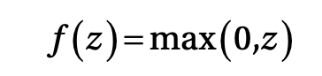
Activation Functions ($f(z)$)
Hyperbolic Tangent
ReLU (Rectified Linear Unit)

Slide 12
Activation Functions ($f(z)$)
Many others:
Leaky ReLU
Swish
ArcTan
Exponential Linear Unit (ELU)
Softplus

Slide 13
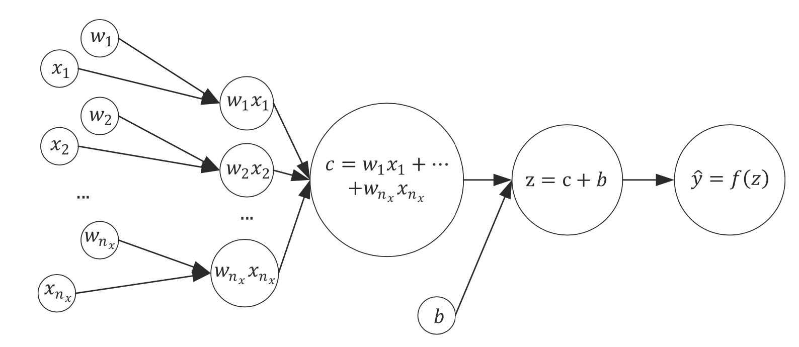
The same network seen as a computational graph
A computational graph is a directed graph where the nodes correspond to operations or variables. Variables can feed their value into operations, and operations can feed their output into other operations. This way, every node in the graph defines a function of the variables. (From: http://www.deepideas.net/deep-learning-from-scratch-i-computational-graphs/)
Source:Umberto Michelucci, Applied Deep Learning - A Case-Based Approach to Understanding Deep Neural Networks, APRESS 2018

Slide 14
What is a tensor (why TensorFlow?)
In its simplest (and somehow incorrect) definition a Tensor is simply a multi-dimensional array of numbers.
An image is a tensor of 3-dimensions (the horizontal and vertical resolution and the colors, RGB).

Slide 15
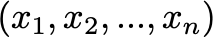
One single neuron - abstraction
Neuron
Nothing else than an operation that transform the inputs tensor into a new one

Slide 16
Learning for a neuron includes 3 steps
A neural network (defined by its architecture, in other words the computational steps to evaluate the network output)
A loss function (a function to measure how good or bad the network is predicting the outputs)
An algorithm to minimize the loss function (also called optimizer)
Source:Umberto Michelucci, Applied Deep Learning - A Case-Based Approach to Understanding Deep Neural Networks, APRESS 2018

Slide 17
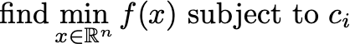
Optimization problem formulation*
Source:Umberto Michelucci, Applied Deep Learning - A Case-Based Approach to Understanding Deep Neural Networks, APRESS 2018
* Nocedal, J. and Wright S. J., Numerical Optimization, Springer Series in Operations Research

Slide 18
Neural Network learning framed as an optimization problem
weights
Loss function
Constraints as a minimum value for a metric (accuracy) or MSE, inference time, etc.*
* a different meaning that what is included in the book by Nocedal J. where the constraints are only for the variable x.

Slide 19
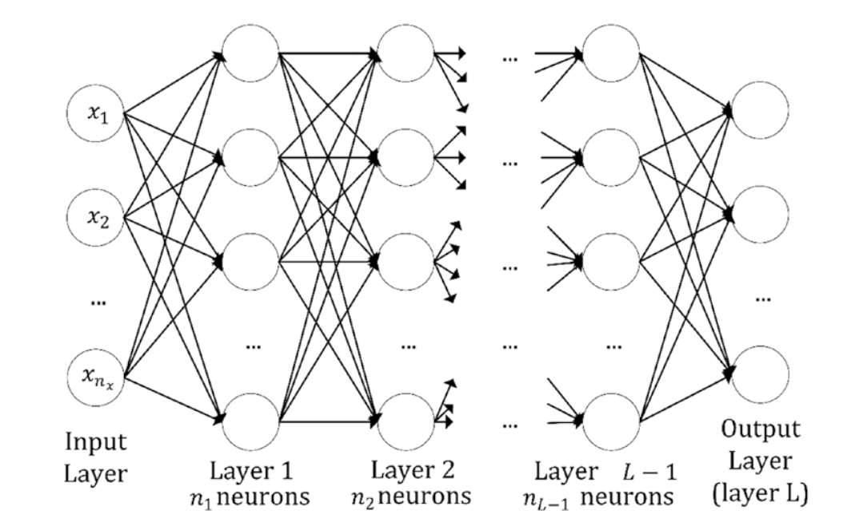
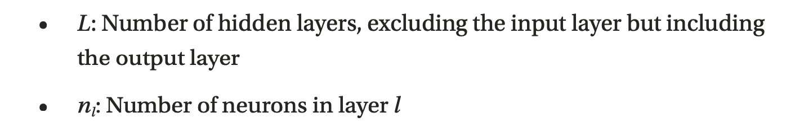
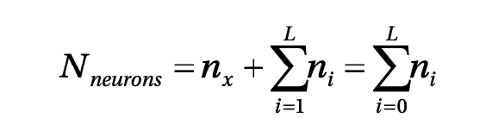
Multiple neurons / multiple layers
Source:Umberto Michelucci, Applied Deep Learning - A Case-Based Approach to Understanding Deep Neural Networks, APRESS 2018

Slide 20
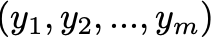
Multiple neurons - abstraction
Layer with m neurons
Nothing else than an operation that transform the inputs tensor into a new one

Slide 21
What can a neuron do?
We have discussed how a neuron looks like. But how can a neuron solve any type of problem?
Can a neuron solve a classification and a regression problem? How can we do that?

Slide 22
Which portion of a neural network model is responsible for the type of problem that can be solved?
Two main components are responsible for the type of problem that can be solved:
The output activation function
The loss function
→ The optimiser is not related in any way to the type of problem solved.

Slide 23
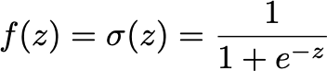
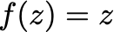
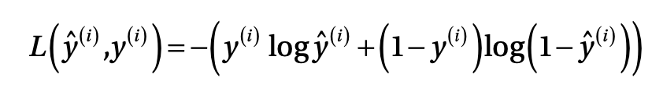
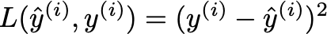
A single neuron can do a lot
Logistic regression
Linear regression

Slide 24
Classification Problem

Slide 25
Neural Network Architecture (example with 3 classes)
How should we interpret those numbers?
We would like to interpret them as the probability of the input observation to be in class 1, 2 or 3.
Network
Input

Slide 26
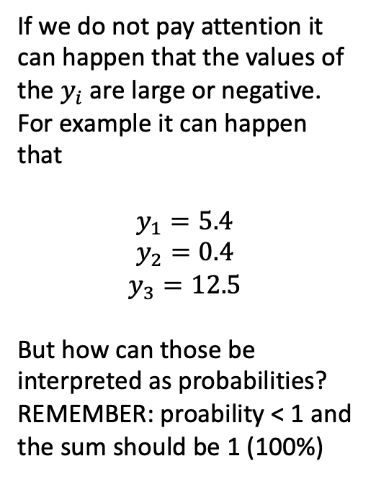
Neural Network Architecture (example with 3 classes)
If we do not pay attention it can happen that the values of the $y_{i}$ are large or negative. For example it can happen that
$$y_{1}=5.4$$
$$y_{2}=0.4$$
$$y_{3}=12.5$$
But how can those be interpreted as probabilities? REMEMBER: proability < 1 and the sum should be 1 (100%)
Network
Input

Slide 27
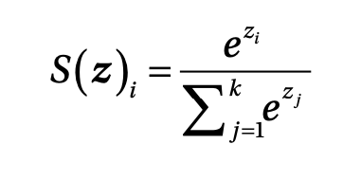
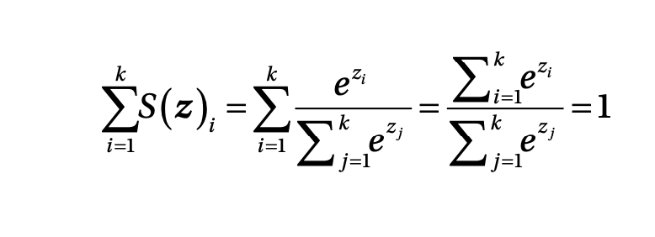
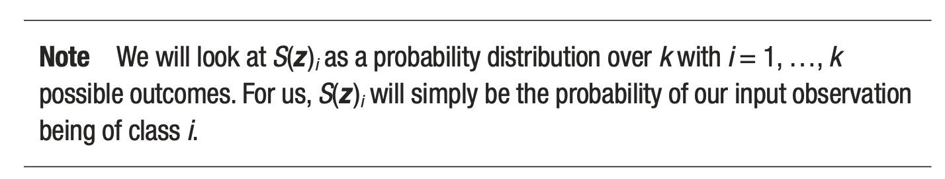
Softmax output layer for classification
Output of ith neuron of the output layer
Note that they can be interpreted as probability since the sum is equal to 1
Source:Umberto Michelucci, Applied Deep Learning - A Case-Based Approach to Understanding Deep Neural Networks, APRESS 2018

Slide 28
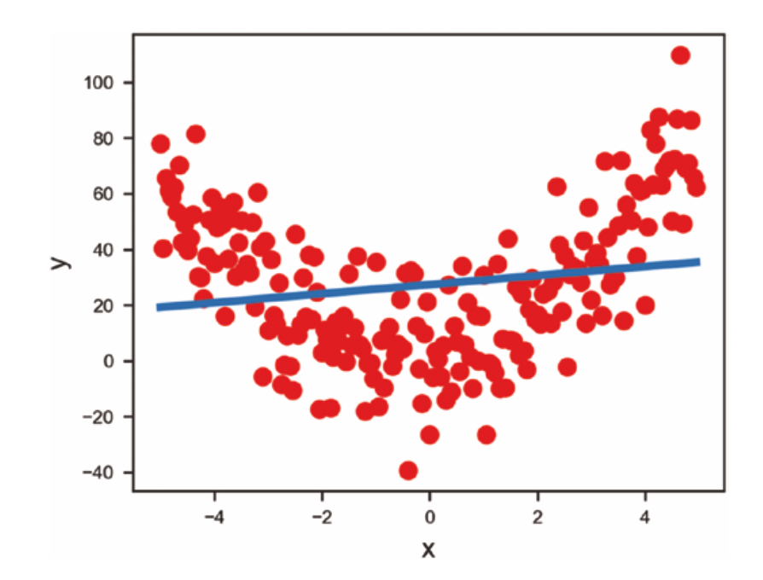
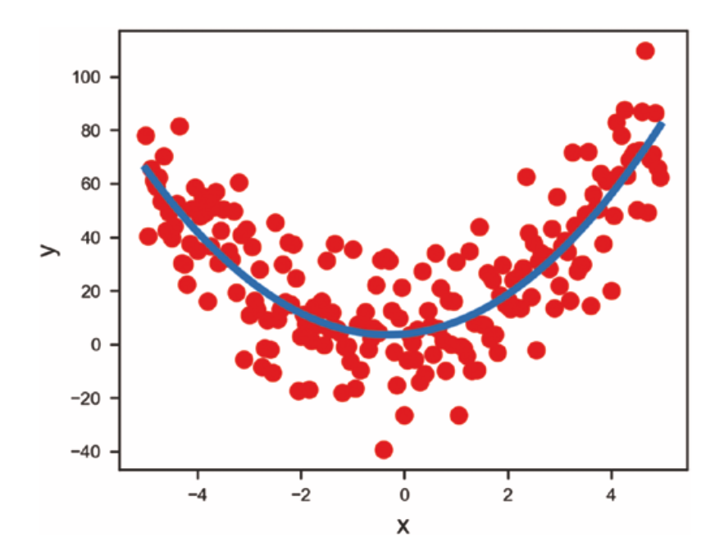
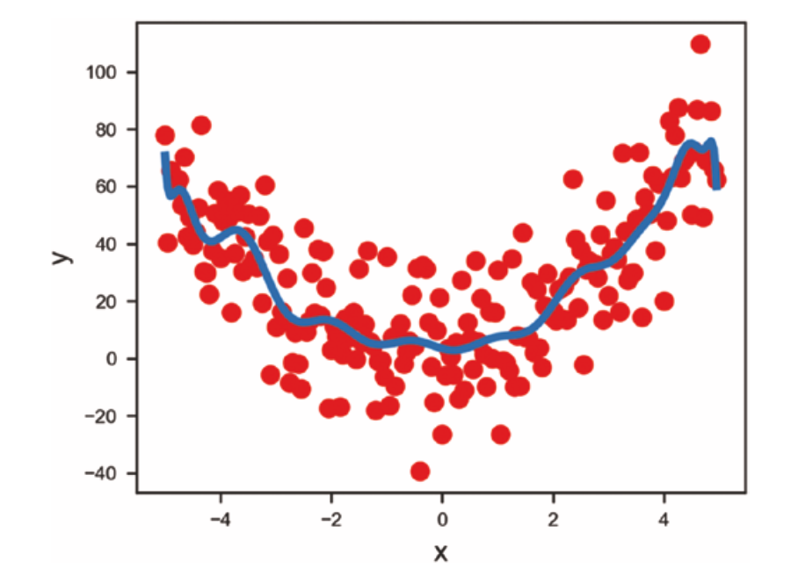
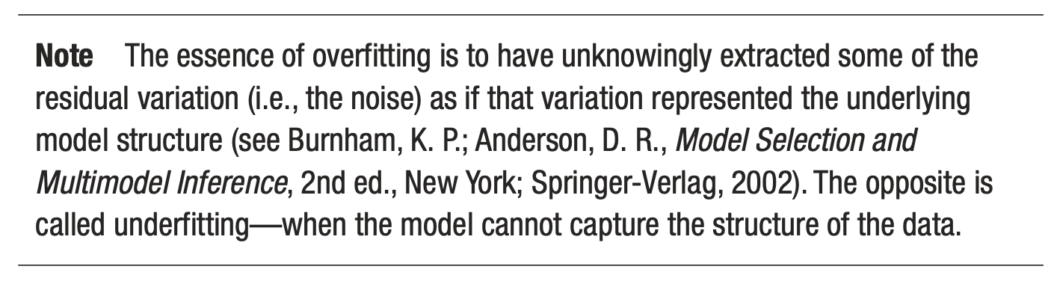
First problem - overfitting
Source:Umberto Michelucci, Applied Deep Learning - A Case-Based Approach to Understanding Deep Neural Networks, APRESS 2018
Underfitting
Just fitting ;-)
Overfitting

Slide 29
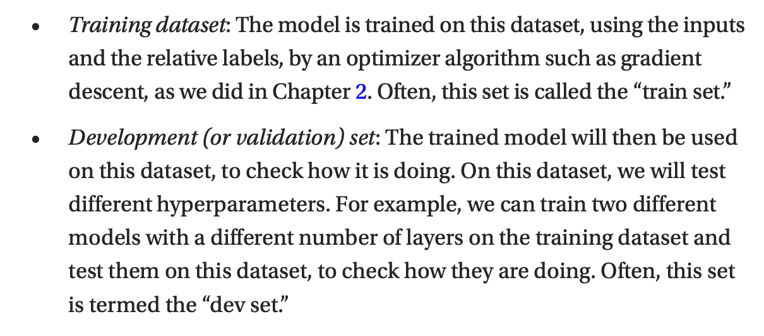
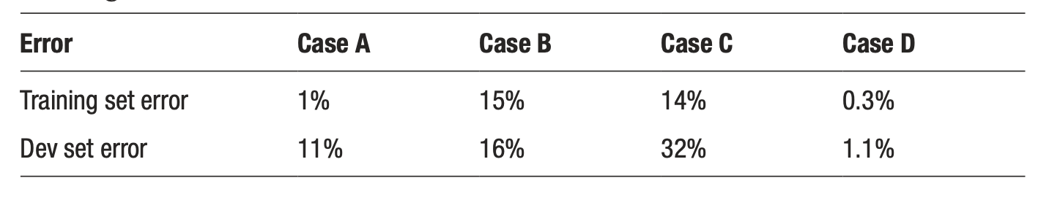
Two datasets to detect overfitting
Source:Umberto Michelucci, Applied Deep Learning - A Case-Based Approach to Understanding Deep Neural Networks, APRESS 2018

Slide 30
Optimizers

Slide 31
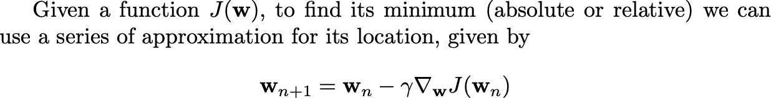
Gradient Descent

Slide 32
First challenge: the right learning rate
https://www.benfrederickson.com/numerical-optimization/

Slide 33
Gradient Descent variations
Batch - Update the weights after all observations have been evaluated
Mini-batch - Update the weights after n observations have been evaluated
Stochastic - Update the weights after each single observations have been evaluated

Slide 34
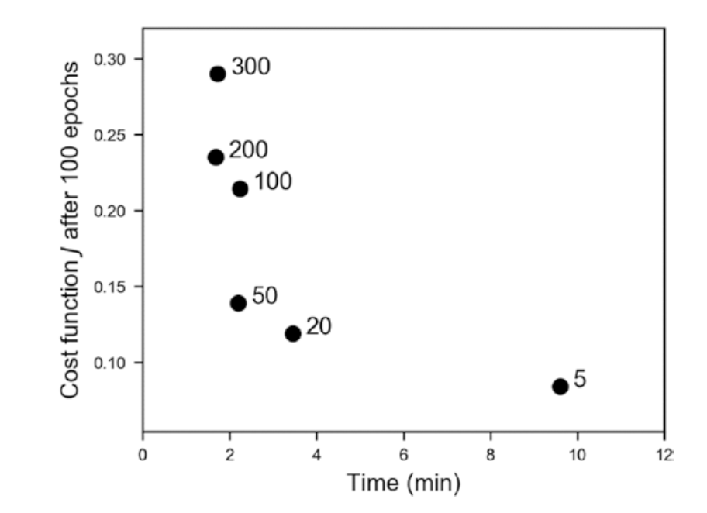
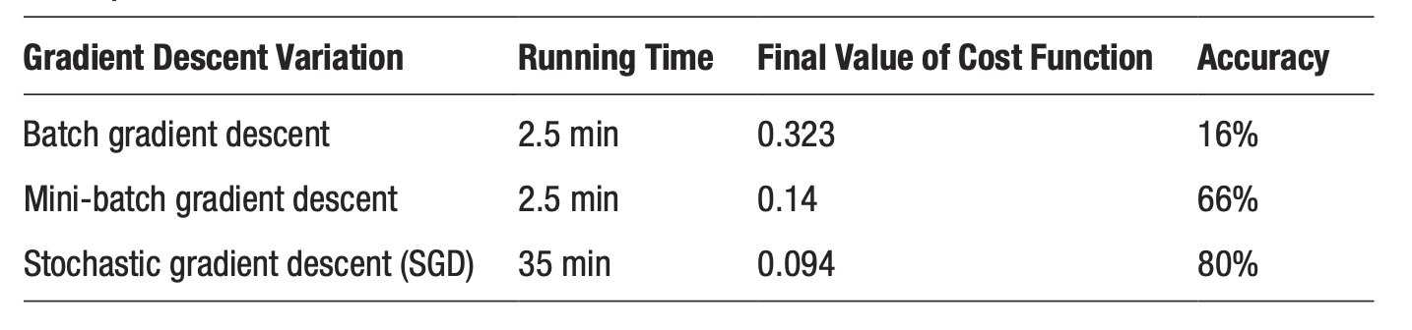
Gradient descent variations - a comparison
Source:Umberto Michelucci, Applied Deep Learning - A Case-Based Approach to Understanding Deep Neural Networks, APRESS 2018

Slide 35
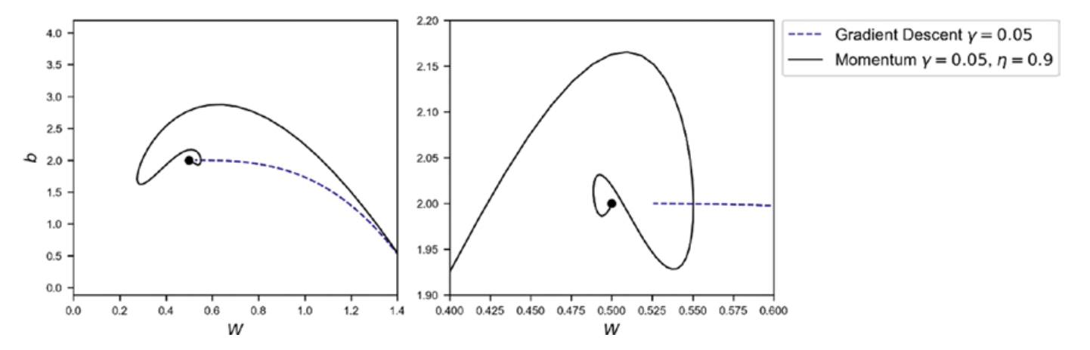
Other optimizers
Momentum
RMSProp
Adam ←
Source:Umberto Michelucci, Applied Deep Learning - A Case-Based Approach to Understanding Deep Neural Networks, APRESS 2018

Slide 36
Regularization

Slide 37
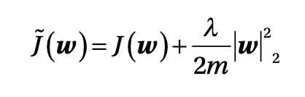
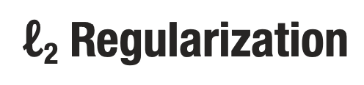
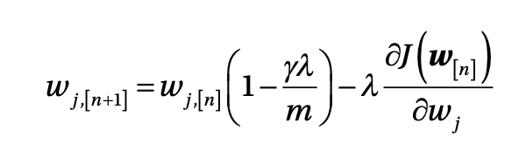
Regularization are techniques to reduce overfitting (let’s discuss…)
Source:Umberto Michelucci, Applied Deep Learning - A Case-Based Approach to Understanding Deep Neural Networks, APRESS 2018

Slide 38
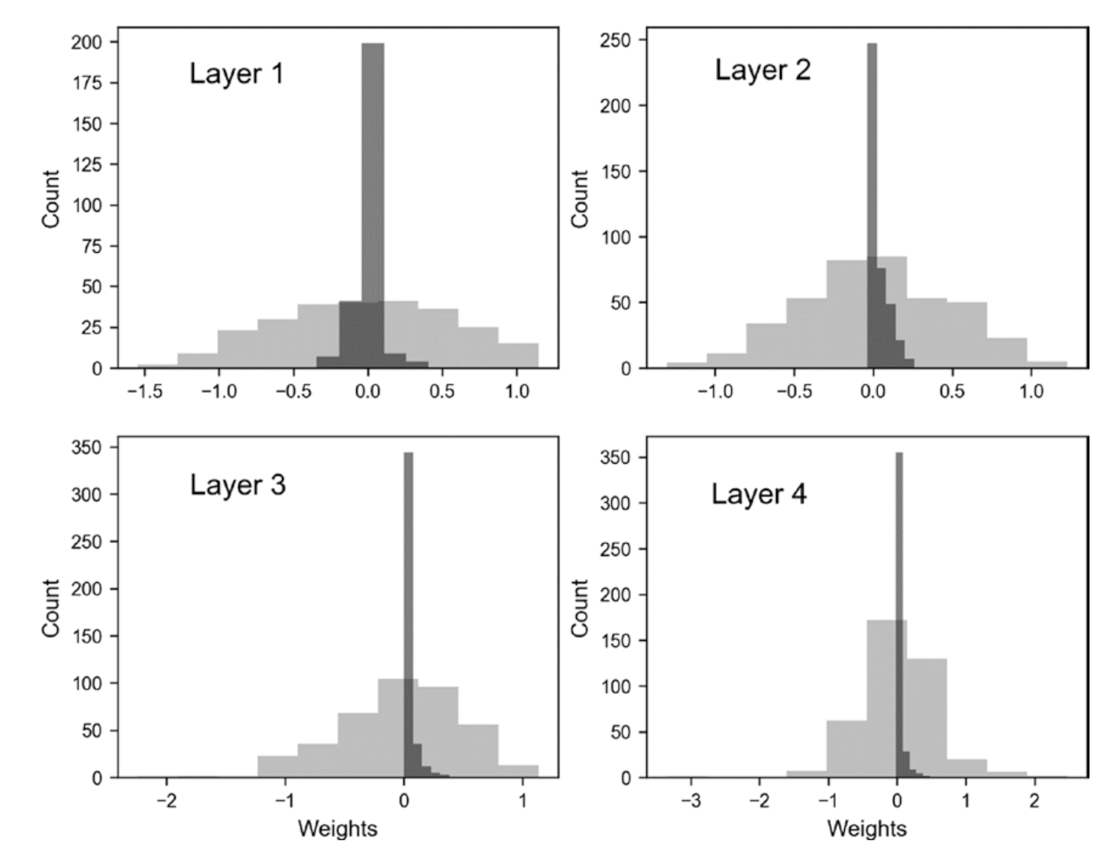
Effect of regularization on the weights
With l2 regularization
Without l2 regularization
Source:Umberto Michelucci, Applied Deep Learning - A Case-Based Approach to Understanding Deep Neural Networks, APRESS 2018

Slide 39
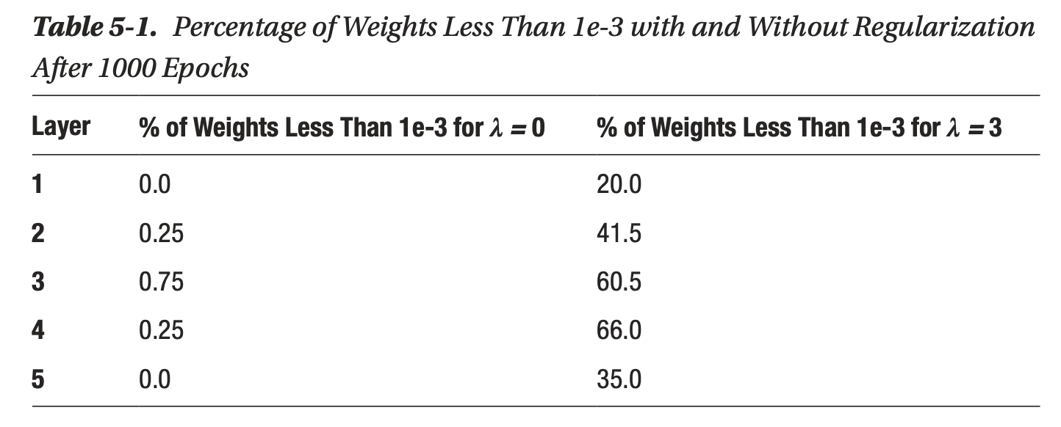
Effect of regularization on the weights
Source:Umberto Michelucci, Applied Deep Learning - A Case-Based Approach to Understanding Deep Neural Networks, APRESS 2018

Slide 40
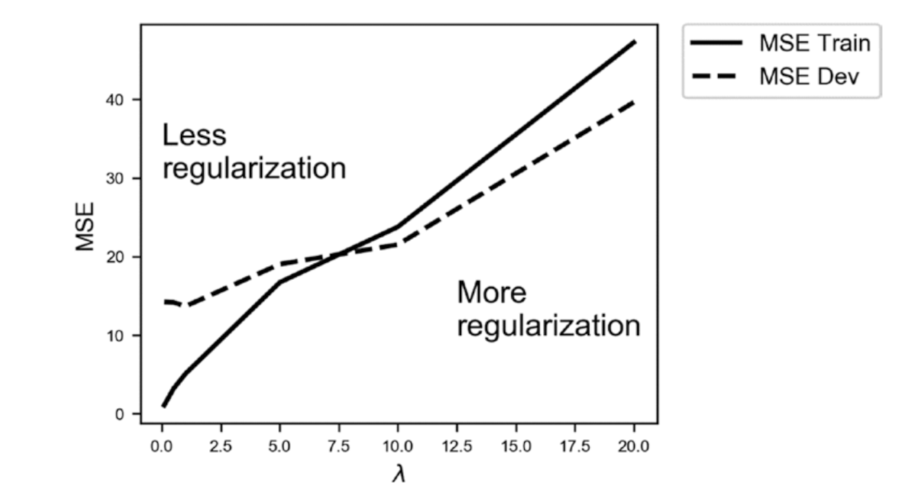
Effect of regularization on the weights
Source:Umberto Michelucci, Applied Deep Learning - A Case-Based Approach to Understanding Deep Neural Networks, APRESS 2018

Slide 41


Effect of regularization
Without
With

Slide 42

L1 regularization

Slide 43
Dropout

Slide 44

A basic explanation
“During training, some number of layer outputs are randomly ignored or “dropped out.” This has the effect of making the layer look-like and be treated-like a layer with a different number of nodes and connectivity to the prior layer. In effect, each update to a layer during training is performed with a different “view” of the configured layer.” [1]
[1] https://machinelearningmastery.com/dropout-for-regularizing-deep-neural-networks/

Slide 45
Additional difficulties
Hyperparameter tuning - finding the best parameters to obtain the best values for the chosen metric
Metric analysis - detecting possible issues with the datasets
Training speed - optimizing to get the fastest training possible
Big datasets - working with amount of data that does not fit in memory anymore

Slide 46
Hands-on Session
https://playground.tensorflow.org

Slide 47
From here the only limit is your creativity!

